Slide 1
Romans 8:1-13

Slide 2
8 There is therefore now no condemnation for those who are in Christ Jesus. ² For the law of the Spirit of life has set you free in Christ Jesus from the law of sin and death. ³ For God has done what the law, weakened by the flesh, could not do. By sending his own Son in the likeness of sinful flesh and for sin, he condemned sin in the flesh, ⁴ in order that the righteous requirement of the law might be fulfilled in us, who walk not according to the flesh but according to the Spirit.

Slide 3
⁵ For those who live according to the flesh set their minds on the things of the flesh, but those who live according to the Spirit set their minds on the things of the Spirit. ⁶ For to set the mind on the flesh is death, but to set the mind on the Spirit is life and peace. ⁷ For the mind that is set on the flesh is hostile to God, for it does not submit to God’s law; indeed, it cannot. ⁸ Those who are in the flesh cannot please God.

Slide 4
⁹ You, however, are not in the flesh but in the Spirit, if in fact the Spirit of God dwells in you. Anyone who does not have the Spirit of Christ does not belong to him. ¹⁰ But if Christ is in you, although the body is dead because of sin, the Spirit is life because of righteousness. ¹¹ If the Spirit of him who raised Jesus from the dead dwells in you, he who raised Christ Jesus from the dead will also give life to your mortal bodies through his Spirit who dwells in you.

Slide 5
¹² So then, brothers, we are debtors, not to the flesh, to live according to the flesh. ¹³ For if you live according to the flesh you will die, but if by the Spirit you put to death the deeds of the body, you will live.

Slide 6
Freedoms and responsibilities change, depending on our location
To be “in Christ” = freedom + responsibility

Slide 7
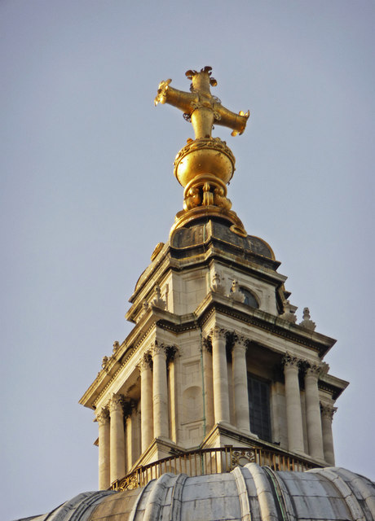
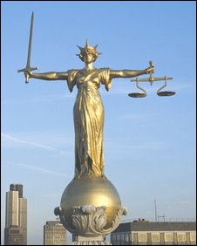

Slide 8
Freedoms and responsibilities change, depending on our location
To be “in Christ” = freedom + responsibility
A recap:
All have sinned and deserve punishment.
Jesus bore our punishment, and set us free from sin and death.
But we still struggle to do the right thing...
Are we bound to feel constant guilt????
^{Romans 8:1} There is therefore now no condemnation for those who are in Christ Jesus.
Freedom!!!
“in Christ” also requires: Repentance; Responsibility; Change
walk, not according to the flesh but according to the Spirit
Those who live according to the Spirit, set their minds on things of the Spirit
to be “in Christ”, means that Christ is in us.
A renewal of the mind: setting our minds on the things of the Spirit. Involves a submission to God’s law (verse 7)
Relationship: We cannot walk by the Spirit if we have no relationship with God
Jesus is Lord: As grateful children, we bow our knee in submission to His will
Obedience: Set our mind on things of the Spirit... and obedient actions will follow

